Slide 1

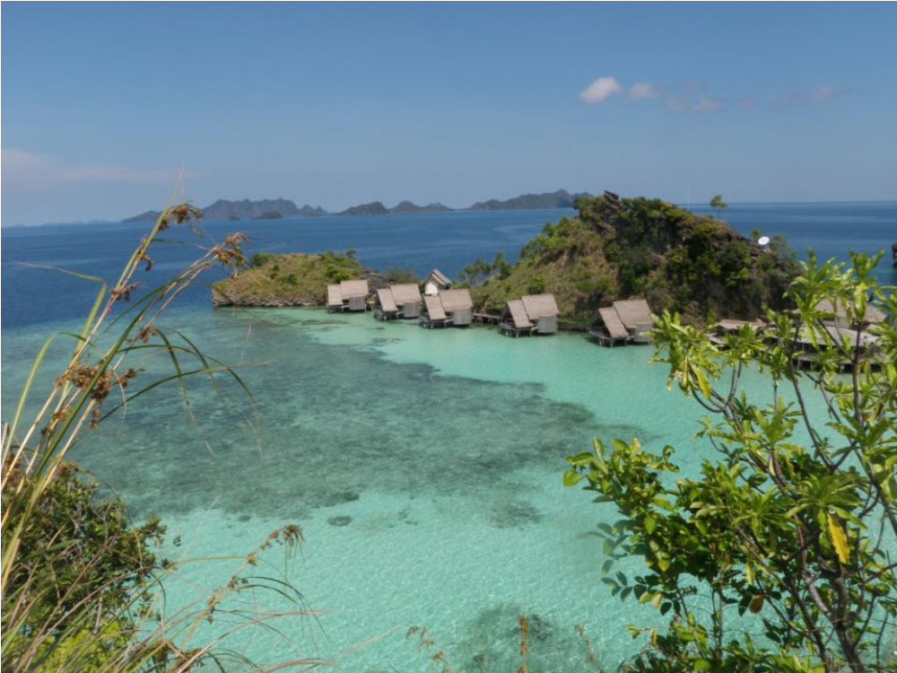
MARINE CONSERVATION AGREEMENT: COMBATING RESOURCE DECLINE IN
RAJA AMPAT, INDONESIA
Pics..
Photo © MER
Purwanto, Muhajir, Joanne Wilson, Andrew Miners,
Jay Udelhoven and Sangeeta Mangubhai
Notes:
.

Slide 2
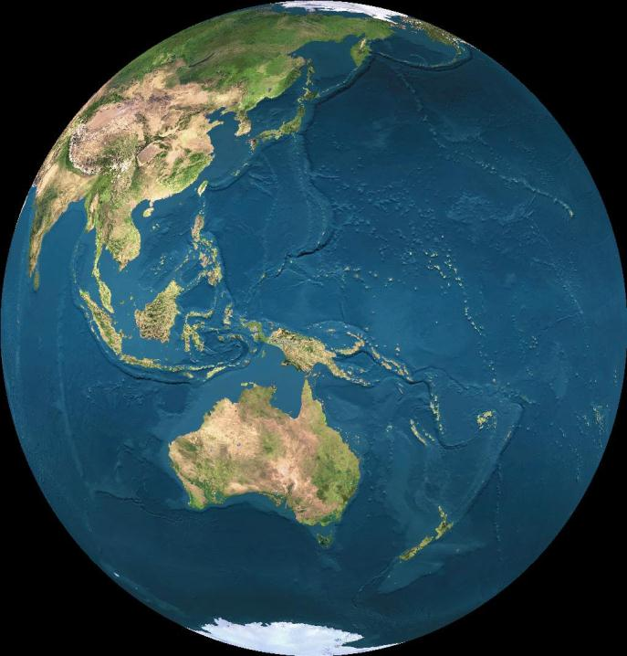

Slide 3
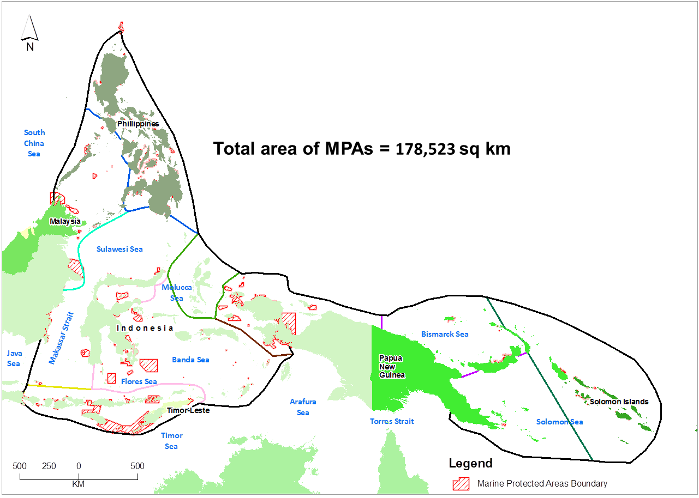
Coral Triangle
Indonesia, Malaysia, Philippines,
Timor Leste, PNG, Solomon Islands
High threat from illegal & destructive fishing
Many MPAs established but less than 1% effectively managed (Burke et al. 2012*)
Map by TNC/Wen Wen

Slide 4
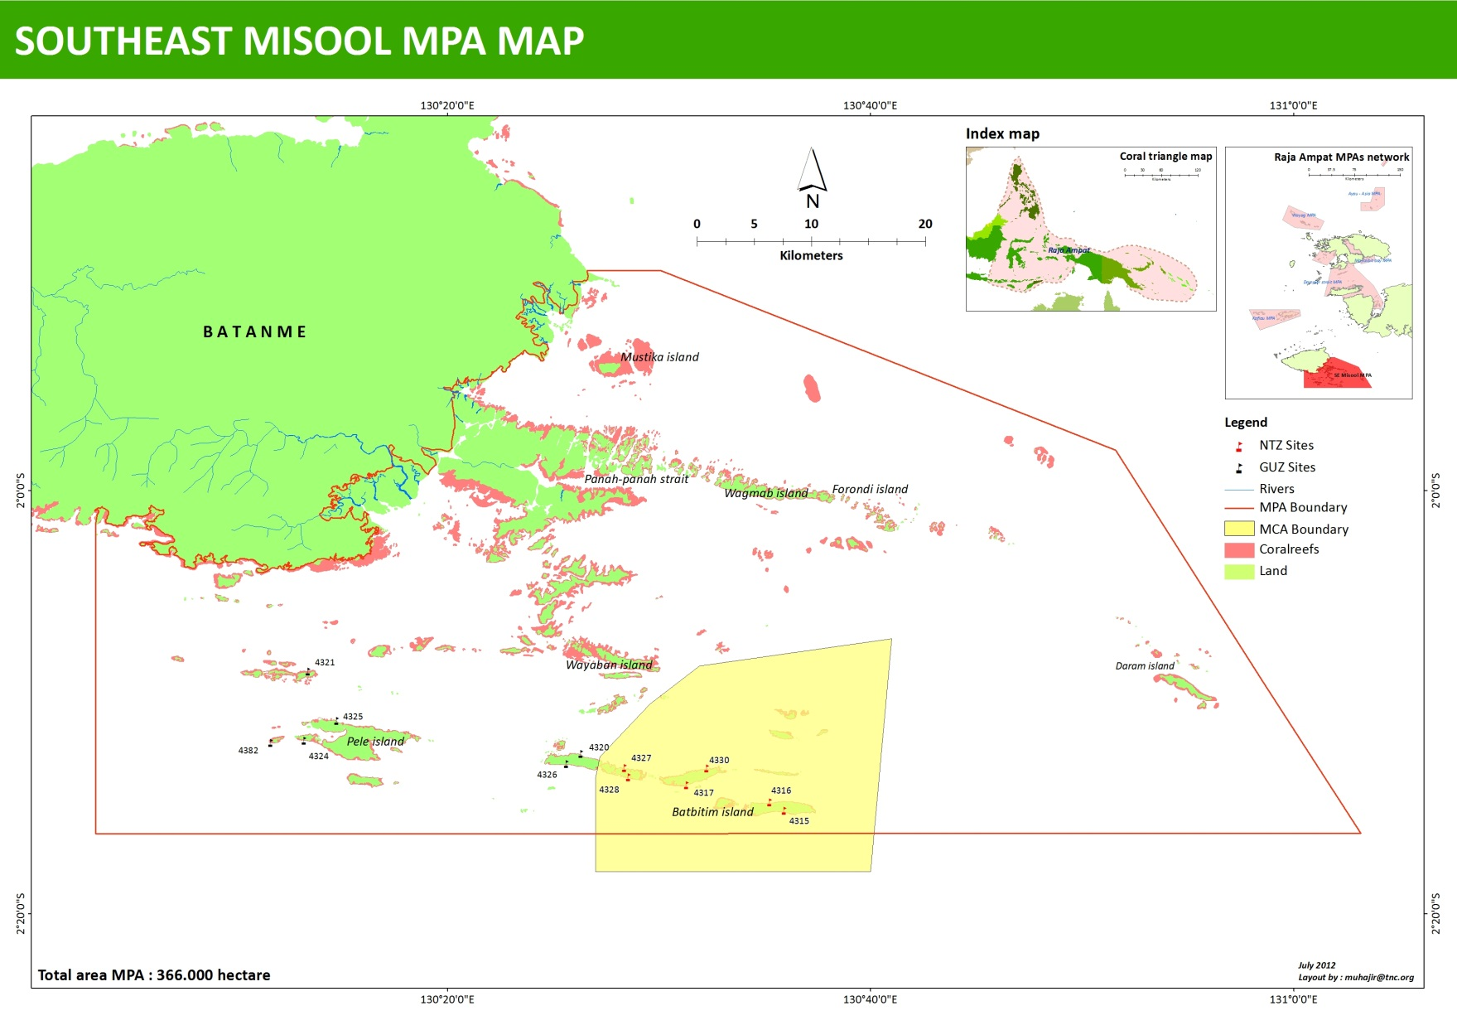
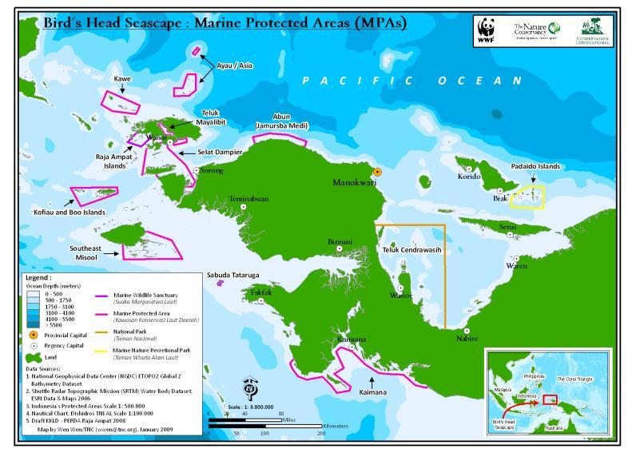
Bird’s Head Seascape MPAs Network
MCA in Misool, Raja Ampat
Map by TNC/Muhajir
Notes:
4

Slide 5
MCA in Misool, Raja Ampat
MCA is any formal or informal understanding in which one or more parties commit to delivering explicit incentives in exchange for one or more other parties committing to take certain actions, refrain from certain actions, or transfer certain rights and responsibilities to achieve agreed-upon ocean or coastal conservation goals i.e. mutually beneficial arrangements.
Lease agreement between Misool Eco Resort with Communities as a traditional owners
Benefit compensation
Communities commitment

Slide 6
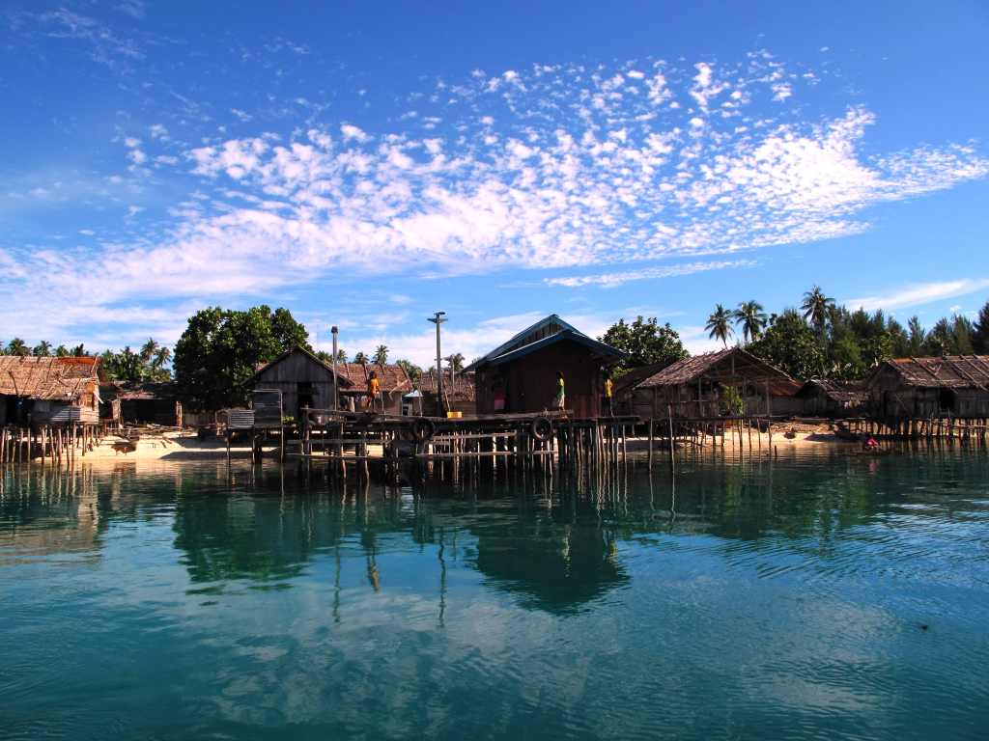
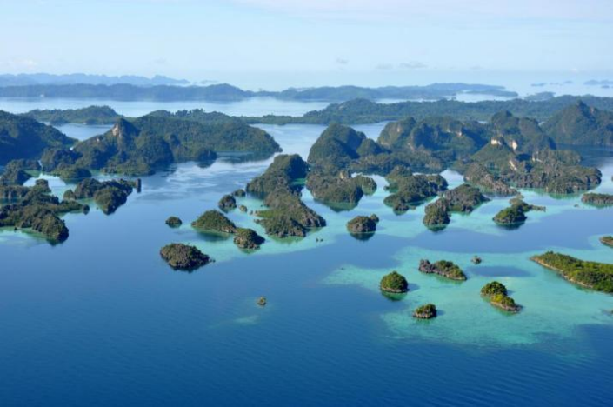
MCA in Misool, Raja Ampat
Explicit incentives =
Cash money, education facilities and medical supplies and appliances to community owners
Agreed upon conservation goals =
establishment of 40,000-hectare NTZ for a 25-years period.
Misool Eco Resort and Yellu village
Photo by TNC/Purwanto
Photo by TNC/Purwanto

Slide 7
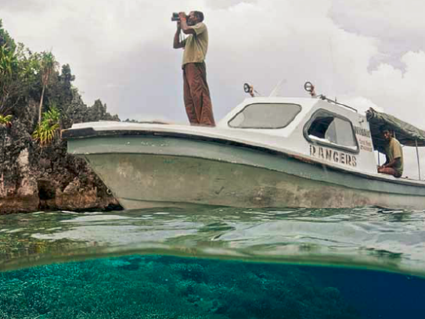
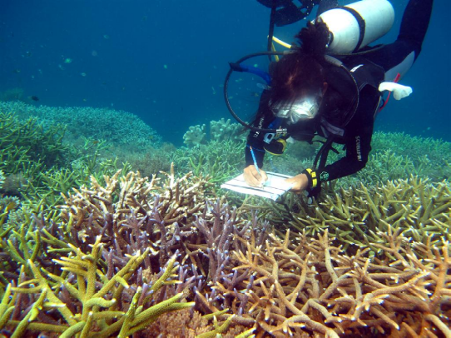
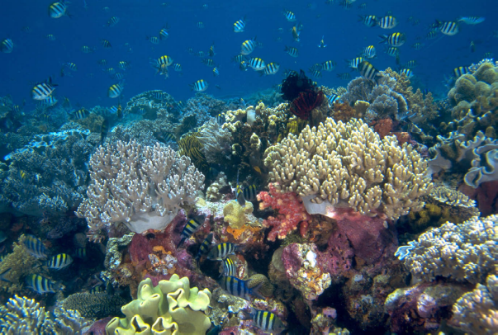
Assessing effectiveness of MCA in Raja Ampat
Assess local patrol implementation
Underwater visual census (Wilson and Green, 2009) – 5 x 50 m transects + long swim (400m)
Compare fish biomass inside and outside MCA
Photo by Jurgen Fruend
Photo by TNC/A. Green
Photo by MER
Notes:
We used 3 types of data to assess the effectiveness of the MER MCA (decide what you are going to call it and have one consistent term throughout the talk)
Make sure you make it clear that you are comparing sites that are comparable ie similar habitat and exposure in this analysis.

Slide 8
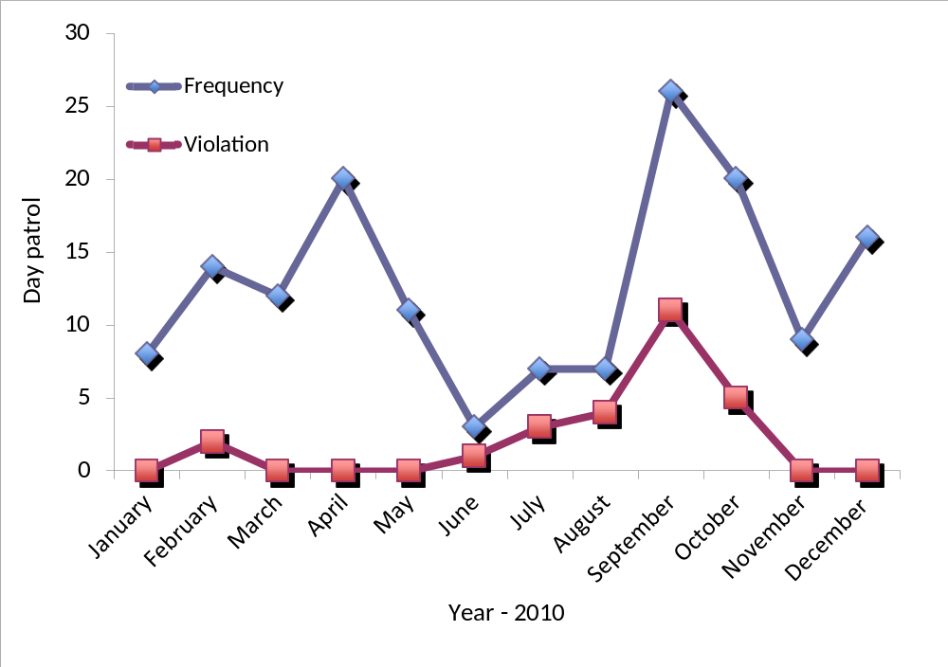
Enforcement within MCA area
Regular patrol conducted by local community with operational support from MER
Customary law and Village regulation to address violation
Source – Misoo Eco Resort & CORAL

Slide 9
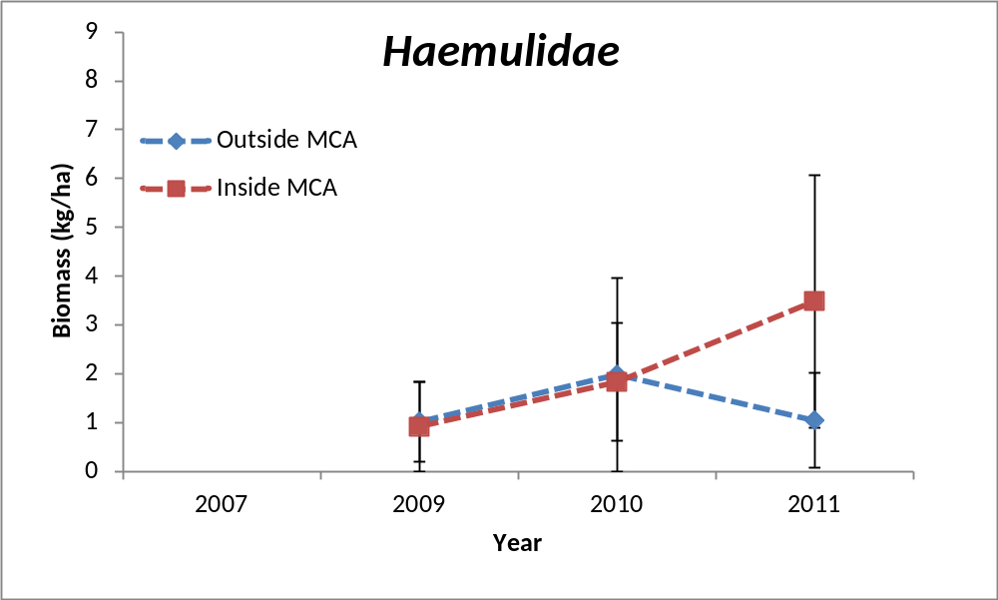
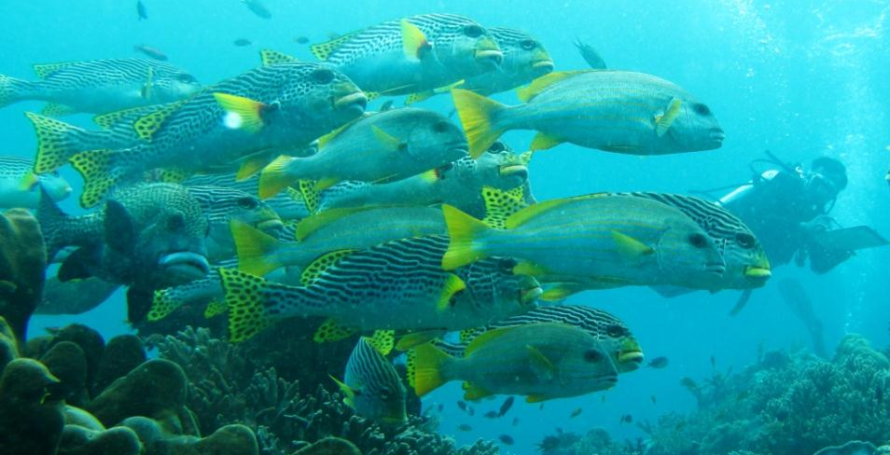
Increasing fish biomass within MCA area
Photo by TNC/Purwanto
MCA implemented
Notes:
At its heart, the campaign is designed to broaden the constituency for conservation, which is one of the three global solutions that conservation leadership has identified.
Additionally, as noted above, the heightened awareness of the Conservancy will help establish our reputation as a significant player among all audiences, which will help us to influence those in power, who may be in a position to impact our ability to be successful.
The Nature Conservancy has launched a multi-year All Hands on Earth campaign to raise awareness and demonstrate how all elements of society can—and must—join forces and take action to safeguard the natural world on which all life depends. For the Conservancy, the Conservation Framework outlined here forms the strategic basis for how our conservation action will evolve to meet formidable challenges, test and deploy innovative solutions and serve as a catalyst for all hands to unite as active partners for a healthy and sustainable Earth.

Slide 10
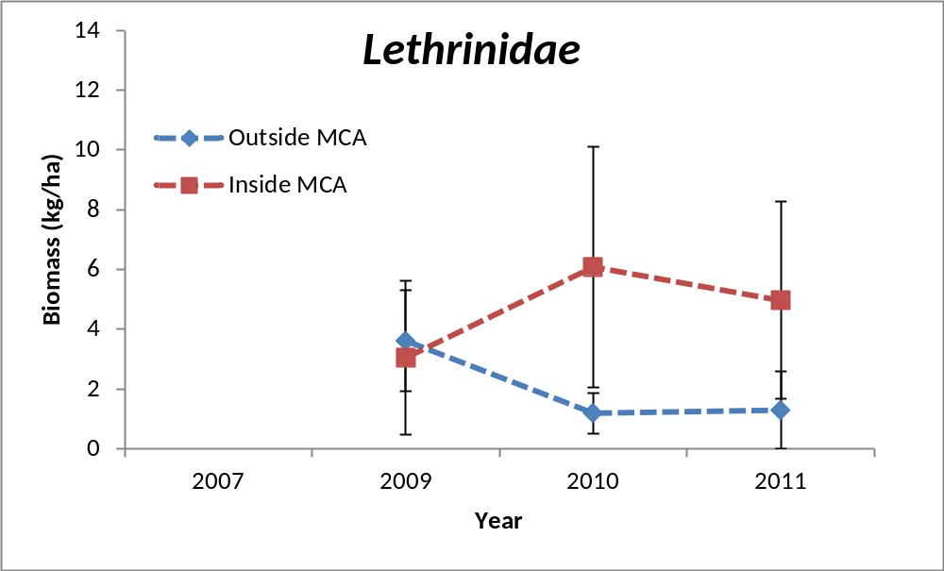
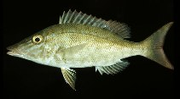
Increasing fish biomass within MCA area
Photo by FishBase.org
MCA implemented
Notes:
At its heart, the campaign is designed to broaden the constituency for conservation, which is one of the three global solutions that conservation leadership has identified.
Additionally, as noted above, the heightened awareness of the Conservancy will help establish our reputation as a significant player among all audiences, which will help us to influence those in power, who may be in a position to impact our ability to be successful.
The Nature Conservancy has launched a multi-year All Hands on Earth campaign to raise awareness and demonstrate how all elements of society can—and must—join forces and take action to safeguard the natural world on which all life depends. For the Conservancy, the Conservation Framework outlined here forms the strategic basis for how our conservation action will evolve to meet formidable challenges, test and deploy innovative solutions and serve as a catalyst for all hands to unite as active partners for a healthy and sustainable Earth.

Slide 11
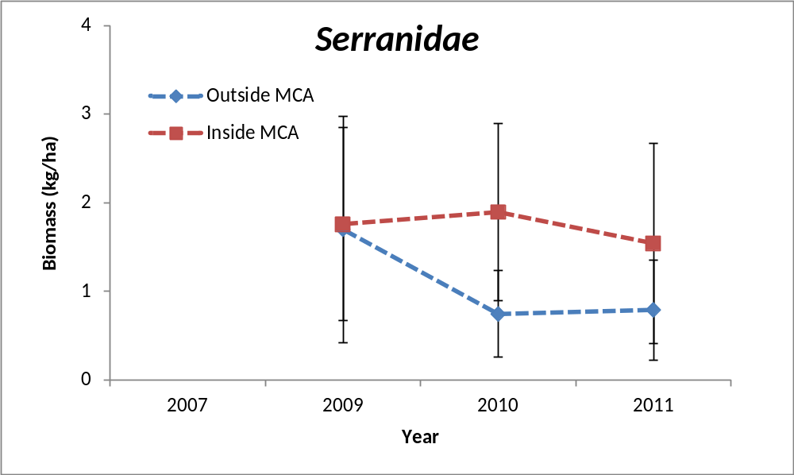
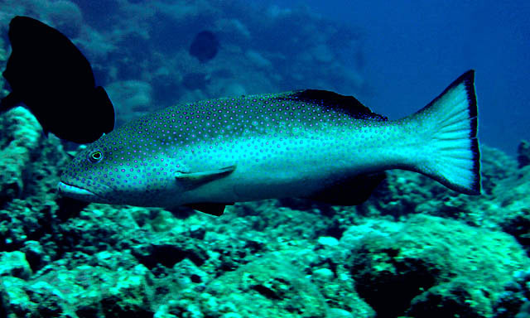
Increasing fish biomass within MCA area
Photo by FishBase.org
MCA implemented
Notes:
At its heart, the campaign is designed to broaden the constituency for conservation, which is one of the three global solutions that conservation leadership has identified.
Additionally, as noted above, the heightened awareness of the Conservancy will help establish our reputation as a significant player among all audiences, which will help us to influence those in power, who may be in a position to impact our ability to be successful.
The Nature Conservancy has launched a multi-year All Hands on Earth campaign to raise awareness and demonstrate how all elements of society can—and must—join forces and take action to safeguard the natural world on which all life depends. For the Conservancy, the Conservation Framework outlined here forms the strategic basis for how our conservation action will evolve to meet formidable challenges, test and deploy innovative solutions and serve as a catalyst for all hands to unite as active partners for a healthy and sustainable Earth.

Slide 12
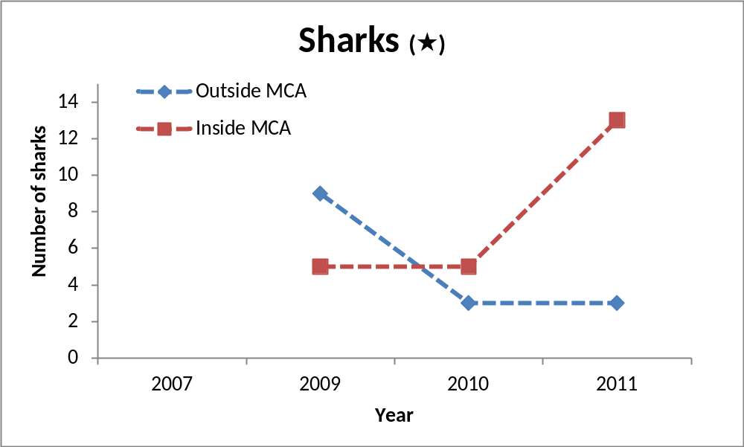
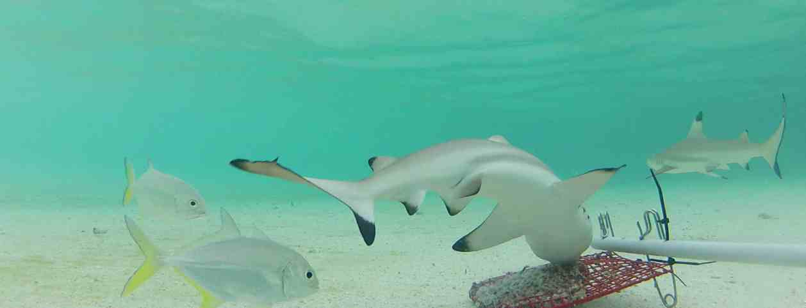
Increasing sharks within MCA area
Photo by Vanessa Jaiteh
MCA implemented
Notes:
At its heart, the campaign is designed to broaden the constituency for conservation, which is one of the three global solutions that conservation leadership has identified.
Additionally, as noted above, the heightened awareness of the Conservancy will help establish our reputation as a significant player among all audiences, which will help us to influence those in power, who may be in a position to impact our ability to be successful.
The Nature Conservancy has launched a multi-year All Hands on Earth campaign to raise awareness and demonstrate how all elements of society can—and must—join forces and take action to safeguard the natural world on which all life depends. For the Conservancy, the Conservation Framework outlined here forms the strategic basis for how our conservation action will evolve to meet formidable challenges, test and deploy innovative solutions and serve as a catalyst for all hands to unite as active partners for a healthy and sustainable Earth.

Slide 13
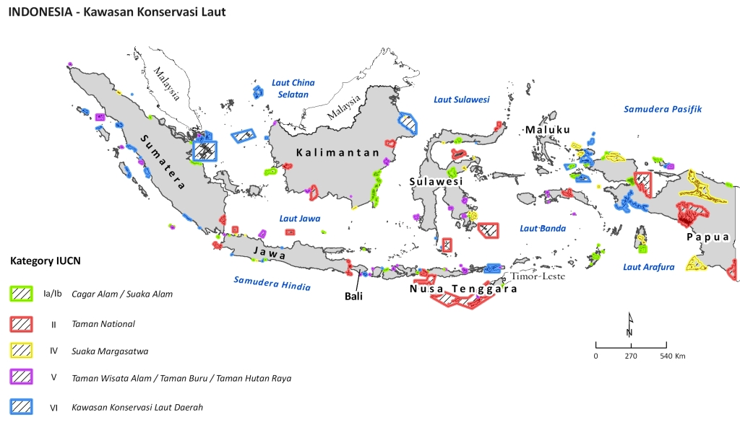
MPAs across Indonesia
Map by TNC/Wen Wen

Slide 14
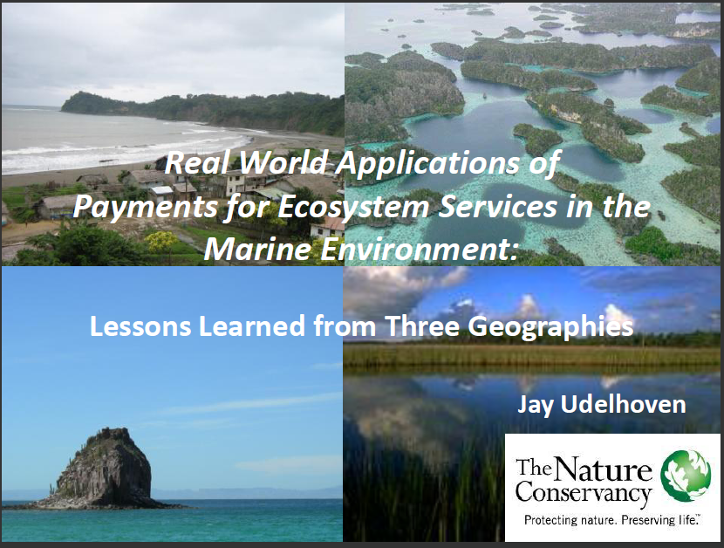
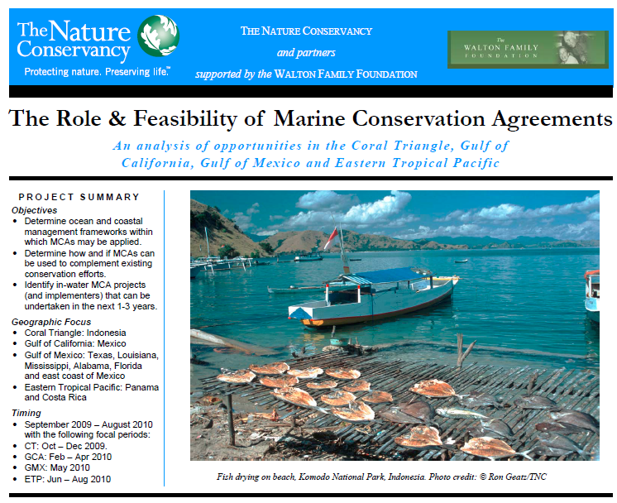
MCA study in Indonesia
20 MCAs in Indonesia – Successful and Unsuccessful
Establishing MCA: Feasibility study, Engagement, Agreement Design and Implementation
Misool MCA is effective implemented (Jay Udelhoven, 2010)
www.mcatoolkit.org

Slide 15
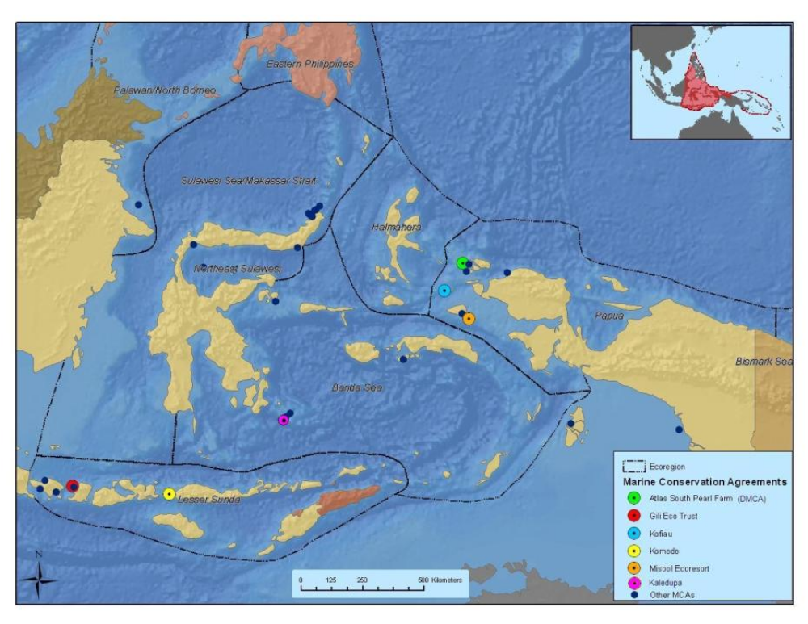
MCAs across Indonesia
Map by TNC/Ben Gilmer

Slide 16
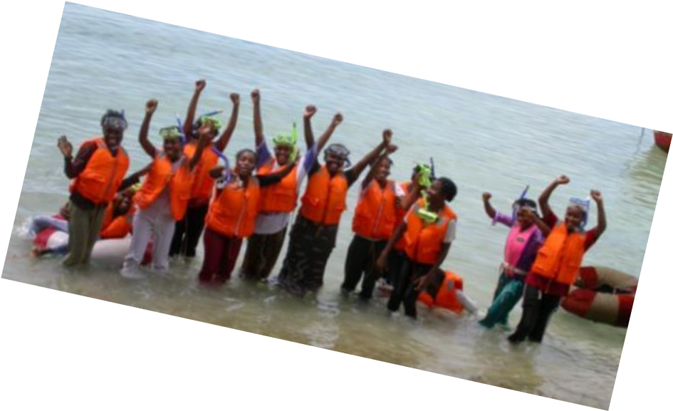
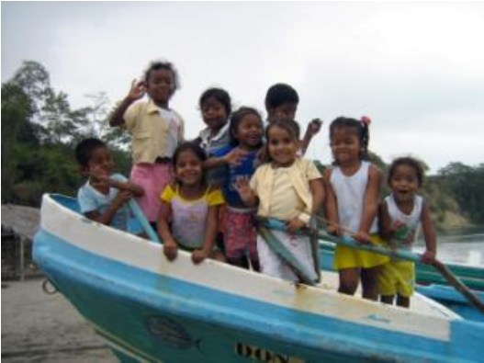
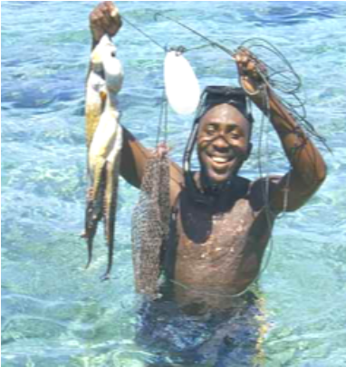
Conclusion
Effectively managed MCA can increase fish biomass and sharks in Raja Ampat
MCA is an alternative tool or model to achieve both tourism and biodiversity conservation goals
MCA strong demonstrate win-win solution between private sector and local communities

Slide 17
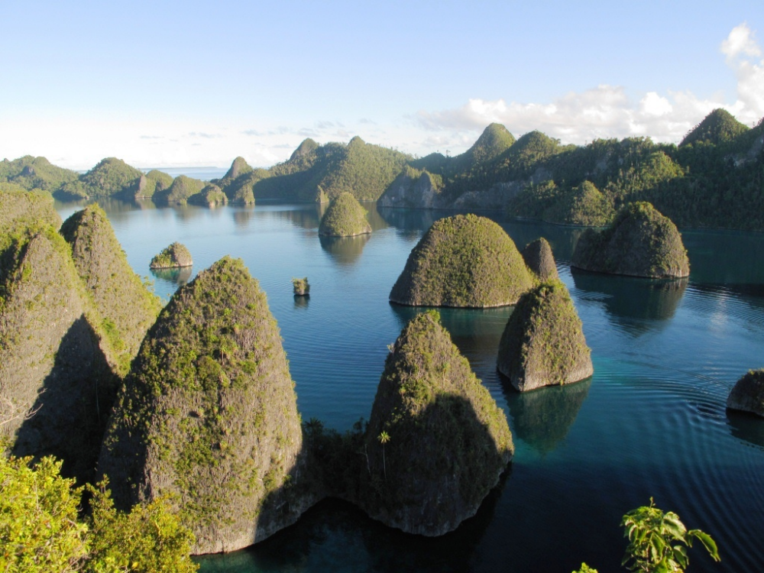
Thanks…
TNC Global Marine Team
Raja Ampat Government
Local communities in Misool
Misool Eco Resort
Misool Baseftin
Coral Alliance
WildAid
Donors - Walton Family Foundation, David and Lucile Packard Foundation, USAID, private donors
Email: purwanto@tnc.org

